Slide 1
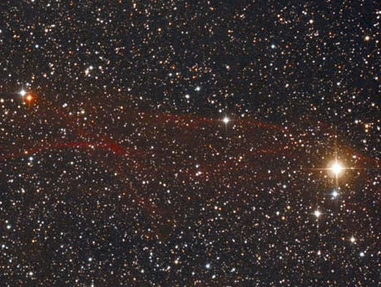
U Cygni

Slide 2
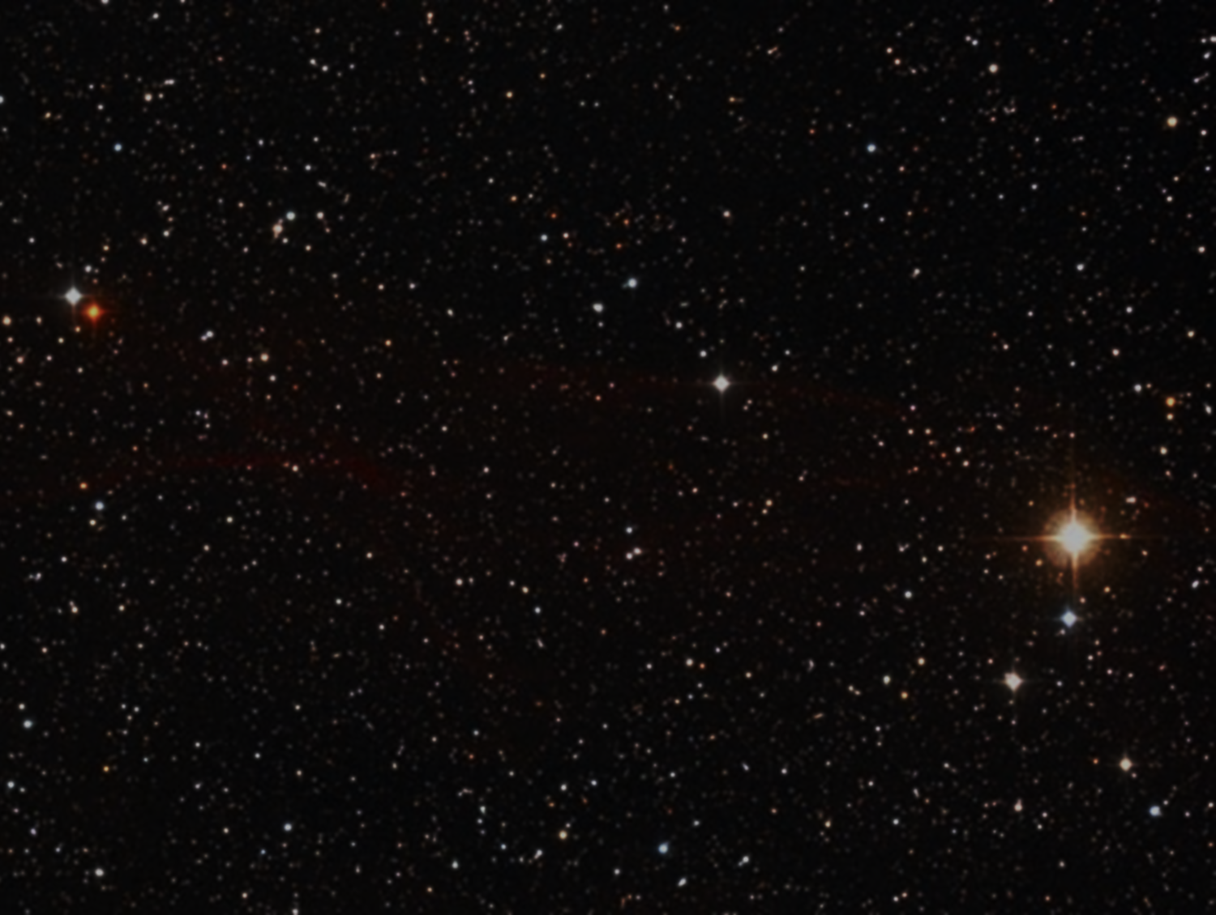
U Cygni
This is a red variable carbon-star giant in the constellation Cygnus. It has a variability period of 463 days. It is a Mira type variable, making it among the coolest, largest and most luminous red giants.

Slide 3
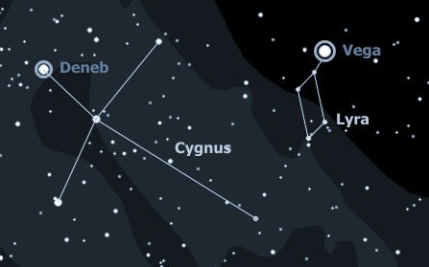
U Cygni

Slide 4
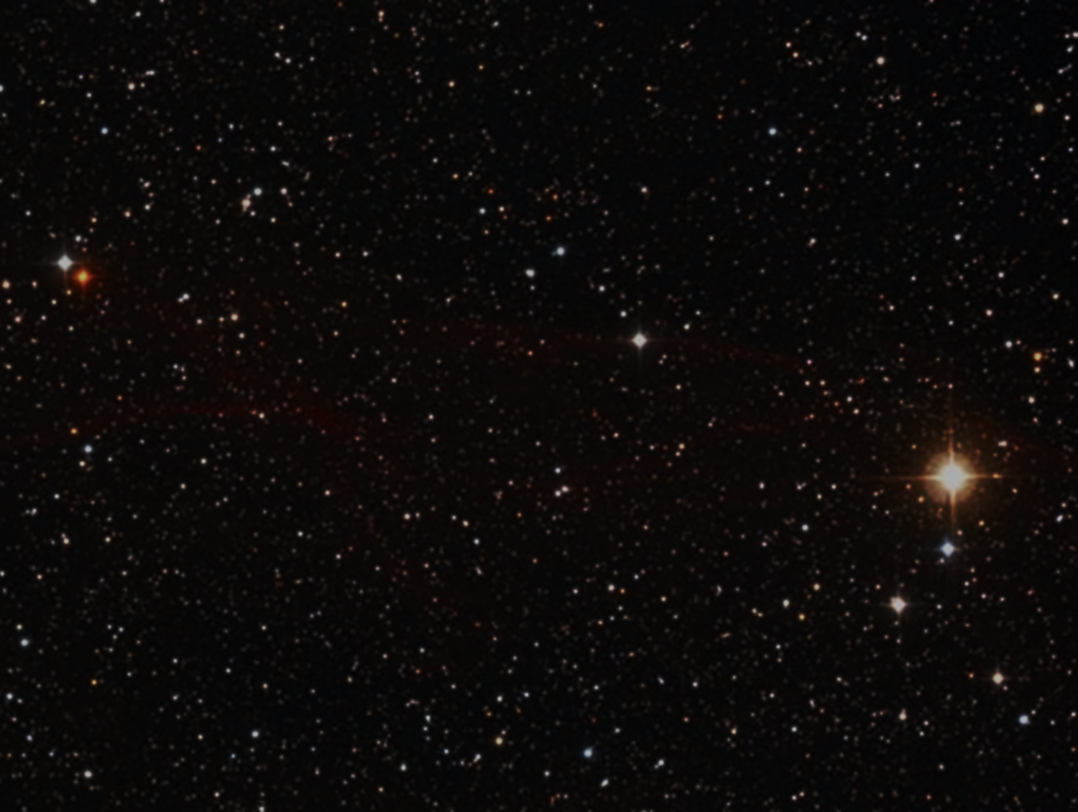
U Cygni
Size: Unknown
B-V Color Index: +3.25, red
Luminosity: 92 suns visual

Slide 5
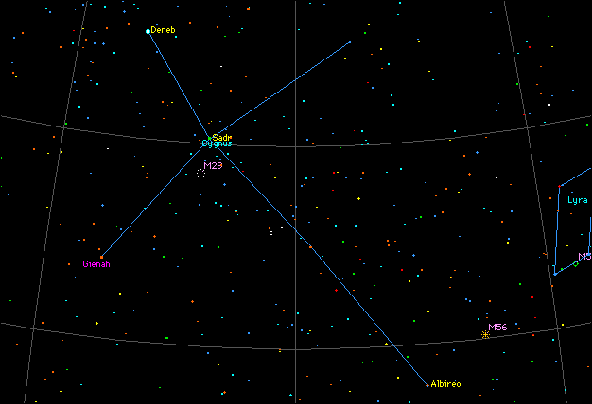
U Cygni
Cygnus
Constellation

Slide 6
U Cygni
Distance: Unknown
Temperature: Variable
Mass: Unknown
Magnitude Range: +5.9 to +12.1

Slide 7
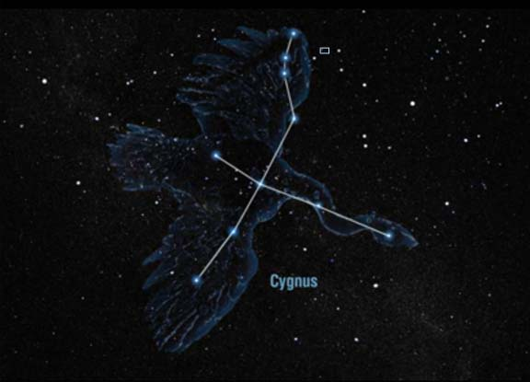
U Cygni

Slide 8

Carbon Star Basics
As sun-like stars age, their core compresses and heats up and basically cooks the helium nuclei into carbon. The convective currents in the star’s atmosphere move the carbon from the core to the outer layers where they form a fine soot. The soot scatters away blue and green light, so only the red and orange wavelengths penetrate the carbon dust to reach our eyes.

Slide 9
Carbon Star Basics
• Sunsets are red for similar reasons to carbon stars. At the horizon, sunlight travels through more atmosphere, scattering away the blues and greens, leaving the red for our eyes.
• All carbon stars are variable and vary in brightness over the course of months or even more than a year.

Slide 10


Slide 11


Carbon Star Basics

Slide 12

Carbon Star Basics
Carbon stars vary in color. What color do you see in the telescope?

